Slide 1
Interception
Session 10
Siti Yuniarti

Slide 2
LO 1: Define Indonesia's cyber law
LO 2: Describe legal problem in cyber
LO 3: Solve legal problem and recommend legal solution
LEARNING OUTCOME

Slide 3
Human Rights & Interception
Indonesia Perspective
TOPICS

Slide 4
Human Rights
Human rights are rights inherent to all human beings, regardless of race, sex, nationality, ethnicity, language, religion, or any other status. Human rights include the right to life and liberty, freedom from slavery and torture, freedom of opinion and expression, the right to work and education, and many more. Everyone is entitled to these rights, without discrimination.
Source: United Nations, https://www.un.org/en/global-issues/human-rights

Slide 5
Human Rights & Internet
The United Nations Special Rapporteur on the Promotion and Protection of the Right to Freedom of Opinion and Expression (Special Rapporteur-2011):
“Unlike any other medium the Internet facilitated the ability of individuals to seek, receive and impart information and ideas of all kinds instantaneously and inexpensively across national borders. By vastly expanding the capacity of individuals to enjoy their right to freedom of opinion and expression, which is an ‘enabler’ of other human rights, the Internet boosts economic, social and political development, and contributes to the progress of humankind as a whole”
“………‘like all technological inventions, the Internet can be misused to cause harm to others”

Slide 6
Human Rights
Derogable Rights
Non-derogable Rights
human rights apply equally online and offline
Public & national interest
Other’s interest
Individual interest
vs
Balance

Slide 7
INTERNET ACTIVITIES
THAT DISTRUPT OF HUMAN RIGHTS
INTERNET ACTIVITIES
SUPPORT FOR HUMAN RIGHTS
Defamation
Cyber bullying
Hate speech
Content modernization
Access blocking
Illegal interception
…..etc
Right of information
Freedom of speech
Freedom of expression
Non-discrimination
vs

Slide 8
A
C
T
O
R
State
Private sector
Individual
Interception
R
E
A
S
O
N
S
National interest
Business
interest
Individual
interest
T
Y
P
E
Legal interception
Illegal interception

Slide 9
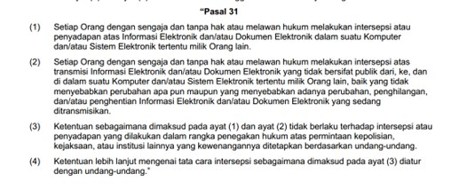
UU No.19/2016 ttg Perubahan UU No.11/2008 ttg ITE
Other regulation in Indonesia

Slide 10
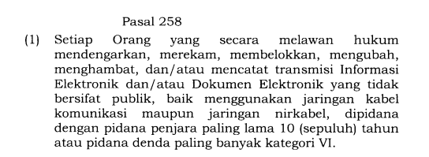
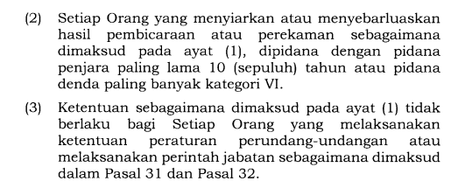
KUHP 2023

Slide 11
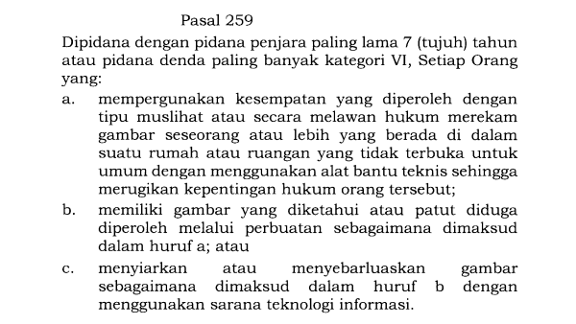
KUHP 2023

Slide 12
DISCUSSION
Bagaimana pengaturan penyadapan di Indonesia?

Slide 13
REFERENSI
Lawrence Lessig. (2008). Code V.2.0. Perseus Book. New York. ISBN: 978-0465039142, Chapter 9
UU No. 11/2008 jo UU No.9/2016 jo UU No. 1/20024

